Slide 1



SQL Marketing Analysis
Presented by
POOJA PATTU E

Slide 2
Business Problem
Understanding Data Complexity in 68K Transactions
Key Insights Required
Central Questions to Address
Insightful marketing strategies are crucial to address issues.
Identifying key questions helps guide the analysis focus.
The complexity of 68,000 transactions creates significant challenges.
Impact on Decision-Making
Overcoming Analytical Challenges
Data volume directly impacts effective decision-making processes.
Tackling data challenges is essential for accurate conclusions.

Slide 3

Data Cleaning Process
Importance of Cleaning Data for Accuracy
Removing Duplicates
Formatting Inconsistencies
Eliminating duplicates prevents skewed results and misleading conclusions.
Standardizing formats helps improve consistency across datasets significantly.
Proper data cleaning ensures accurate analysis and insights.
Handling Missing Values
Essential SQL Commands
Addressing gaps in data maintains integrity of analysis results.
Utilizing SQL commands streamlines the data cleaning process efficiently.

Slide 4
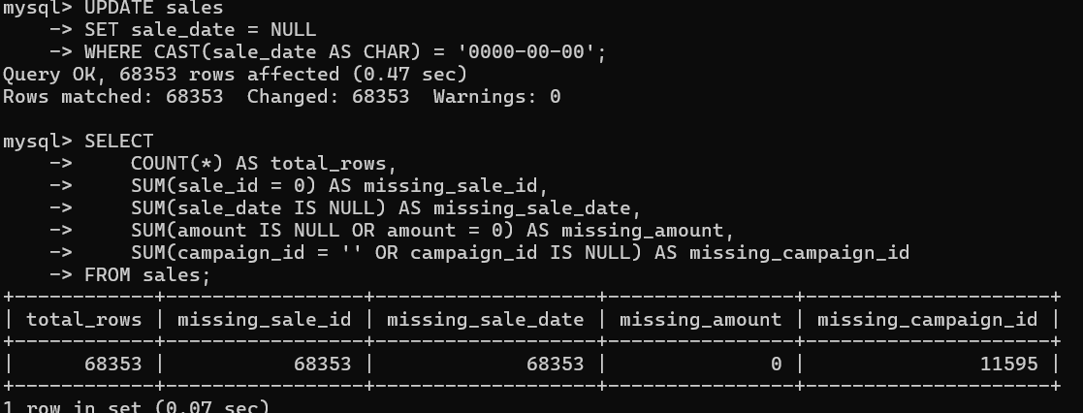
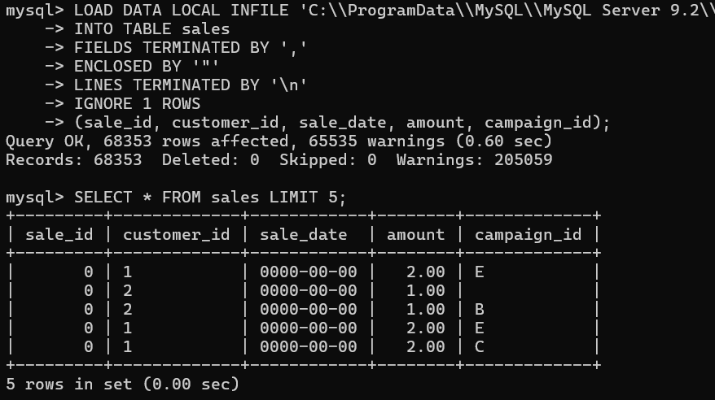
SQL Code Snippet Results
The following SQL code snippet effectively demonstrates our marketing analysis approach, revealing critical insights from the 68K transactions—leading to informed decisions and strategy adjustments.

Slide 5
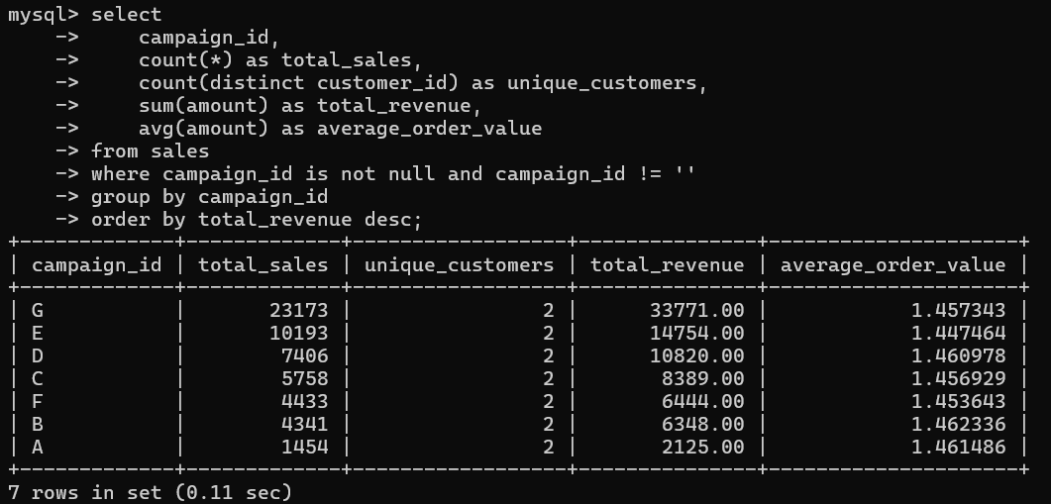
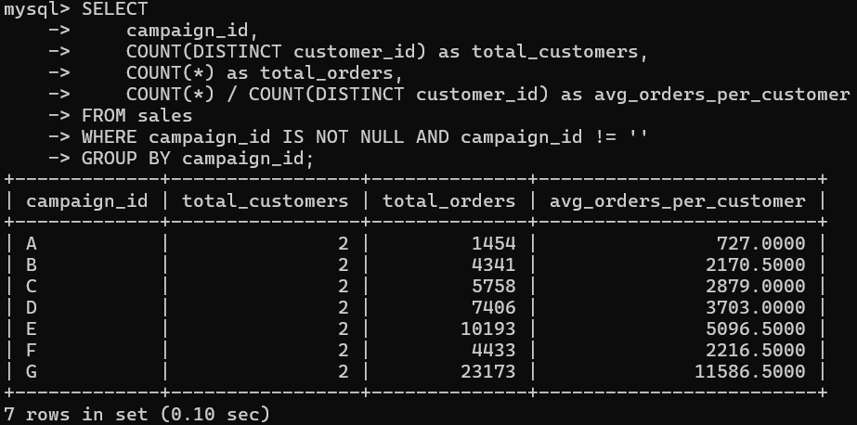
SQL Code Snippet Results
The following SQL code snippet effectively demonstrates our marketing analysis approach, revealing critical insights from the 68K transactions—leading to informed decisions and strategy adjustments.

Slide 6

Business Impact & ROI
Unlocking Marketing Potential
Increased conversions from targeted strategies
Significant cost savings identified through analysis
Clear ROI metrics showcasing campaign success
Quantified impact on decision-making processes

